Slide 1
The Oracle Client Software Install SOP_For Training.

Slide 2
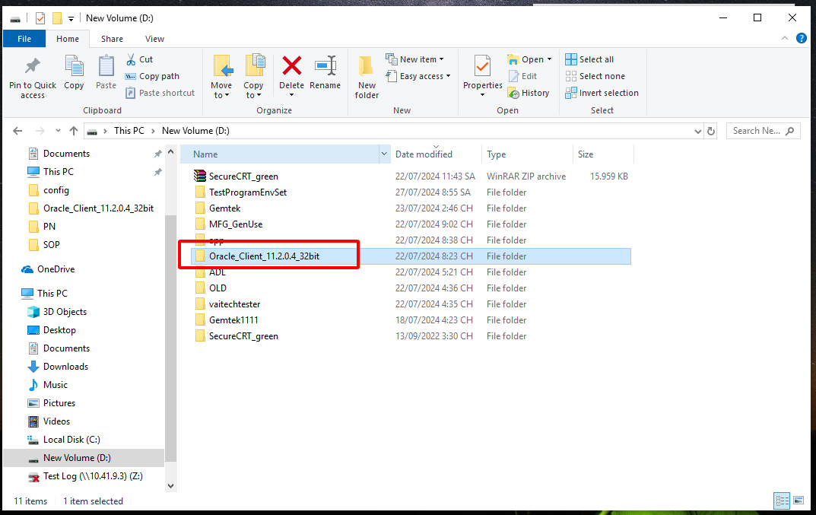
Step 1. Put the folder “ Oracle_Client_11.2.0.4_32bit ” into New Volum (D:)

Slide 3
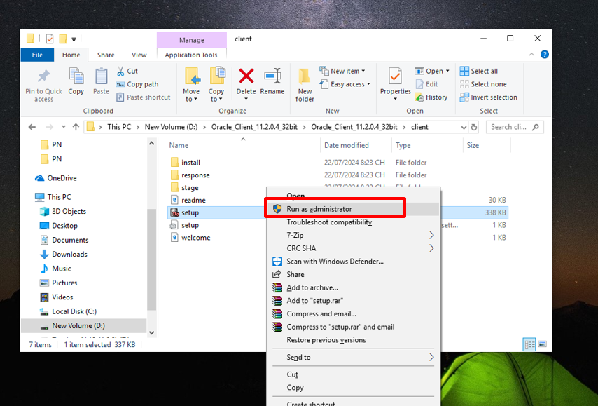
Step 2. Choose “ Setup.exe ” run with “ Run as adminstrator ”

Slide 4
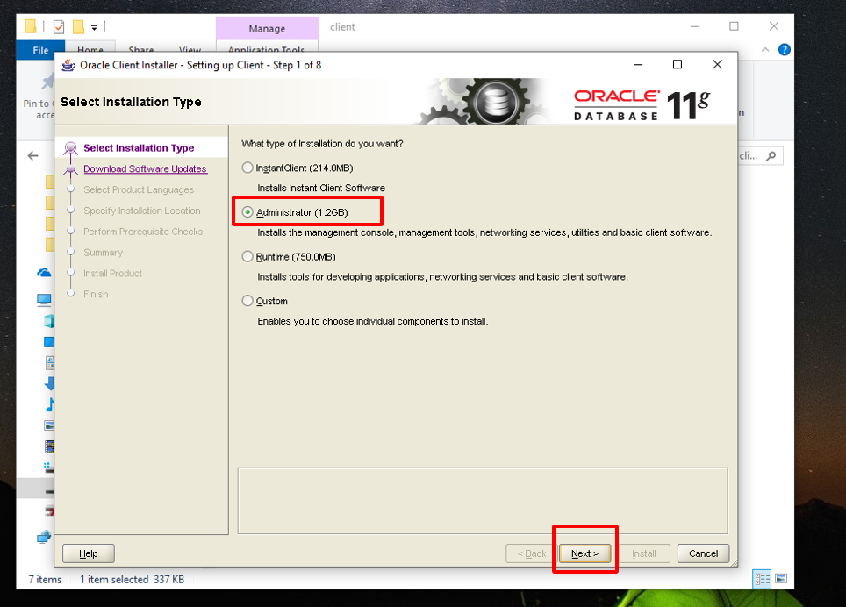
Step 3. Choose “ Adminstrator” and then press “ Next ” to setup continue.

Slide 5
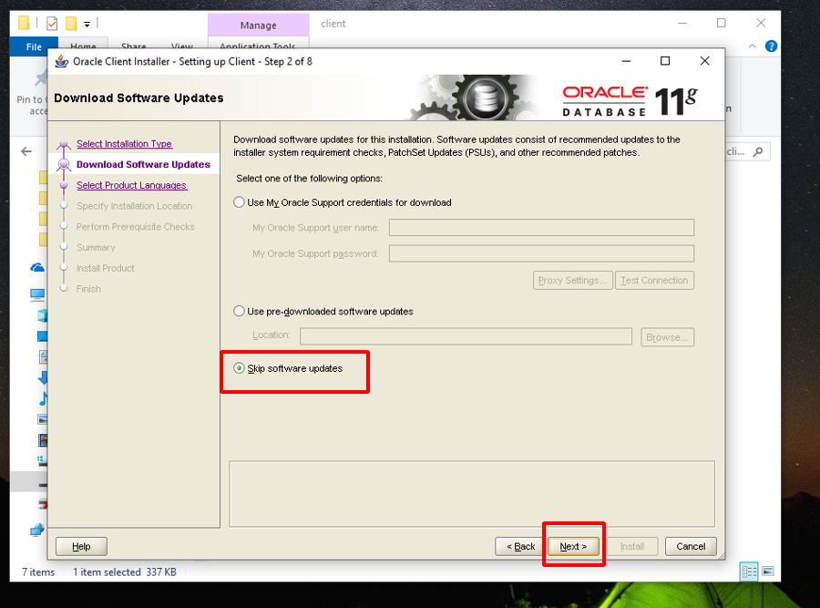
Step 4. Choose “ Skip software update” and then press “ Next ” to setup continue.

Slide 6
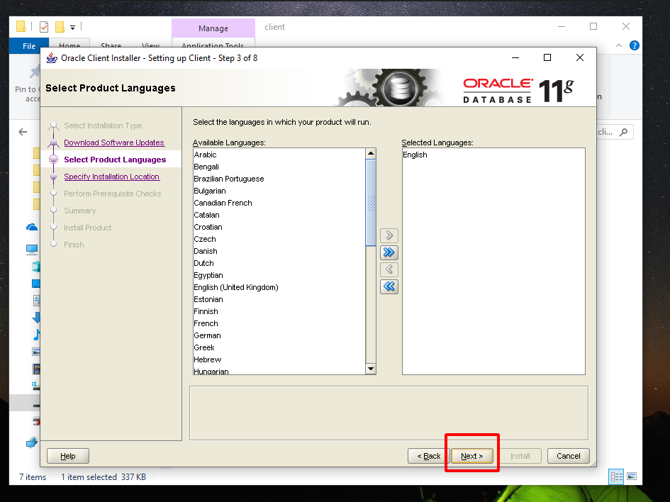
Step 5. Press “ Next “ to setup continue.

Slide 7
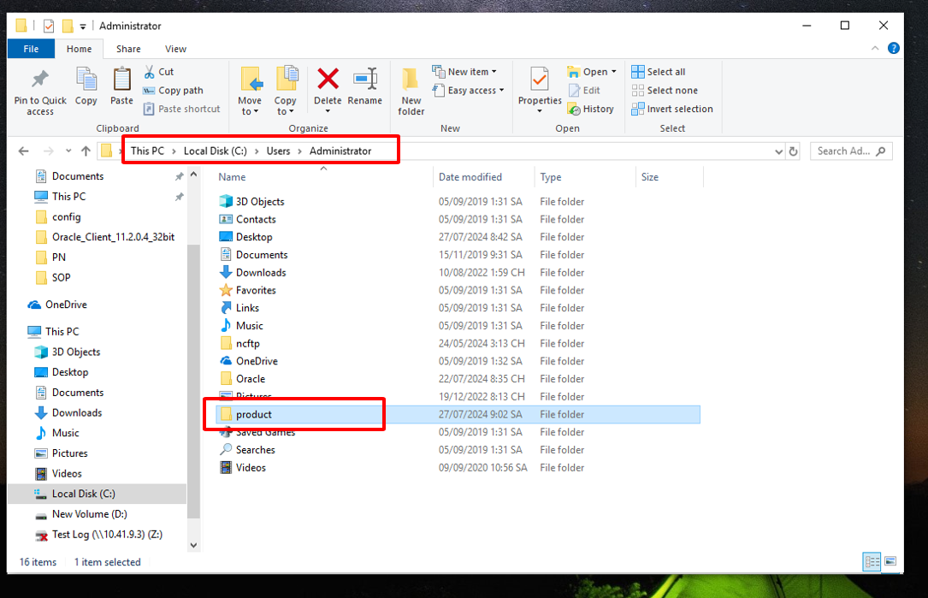
Step 6. Login into “ Local Disk C\ Users\ Adminstrator ” and then create a new folder “product”

Slide 8
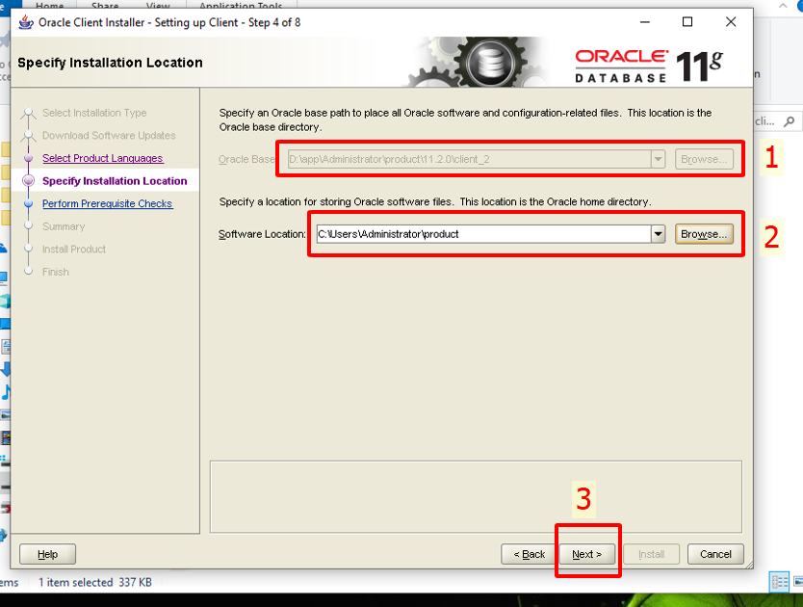
Step 7: 1. Select the location containing the root directory you want to install to. 2. Select the new folder location where you want to install same as path below. “ C\ Users\ Adminstrator\ product ” and then press “ Next ” to setup continue.

Slide 9
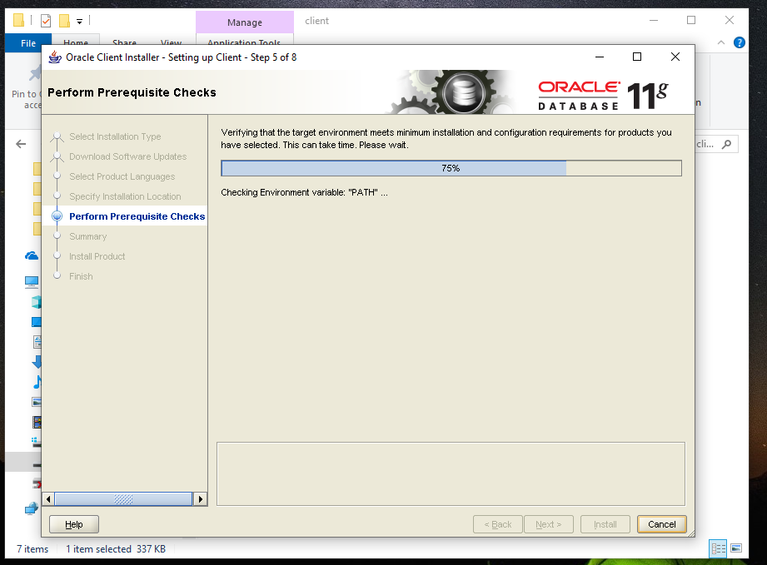
Step 8. Please wait while software setting.

Slide 10
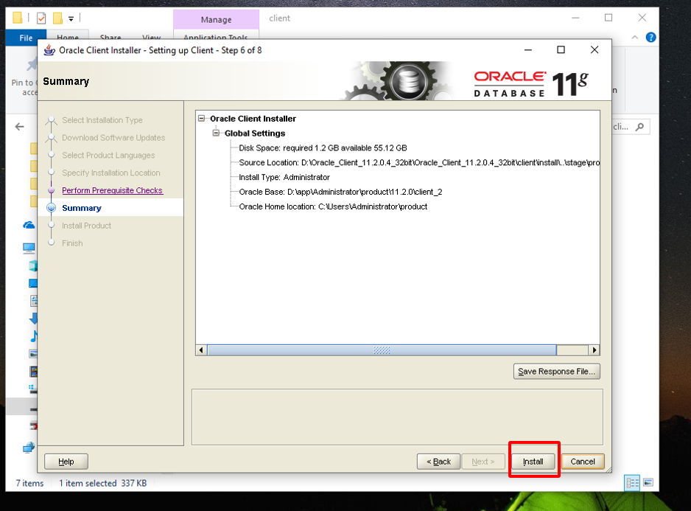
Step 9. Please press “ Install ” for setup continue.

Slide 11
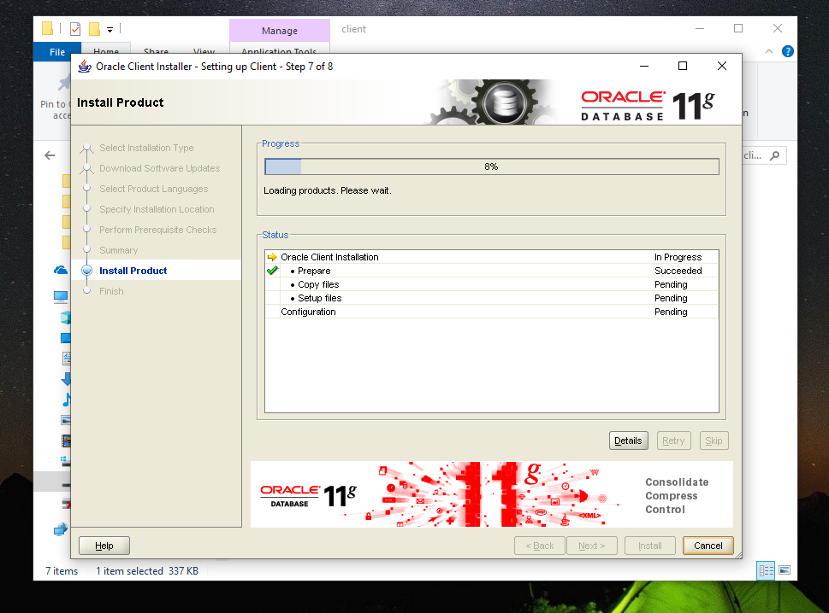
Step 10. Please wait for software install finish.

Slide 12
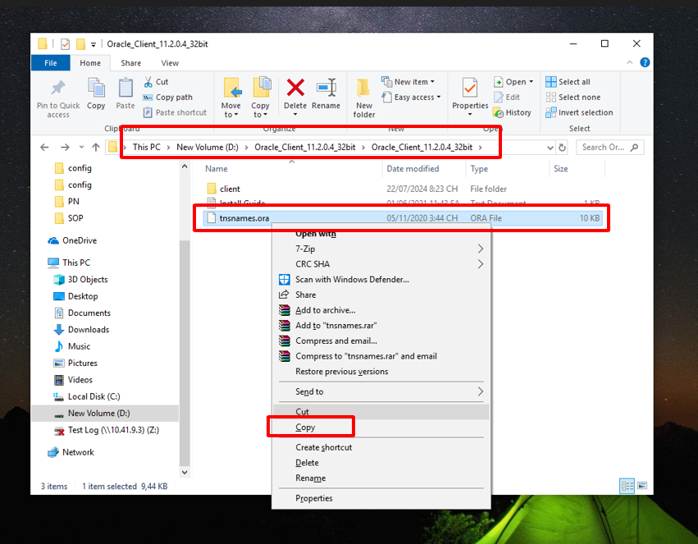
Step 11. 1. Select the file “ tnsnames.ora” inside the root directory same as the path below. 2. Copy the file “ tnsnames.ora” to software install location.

Slide 13
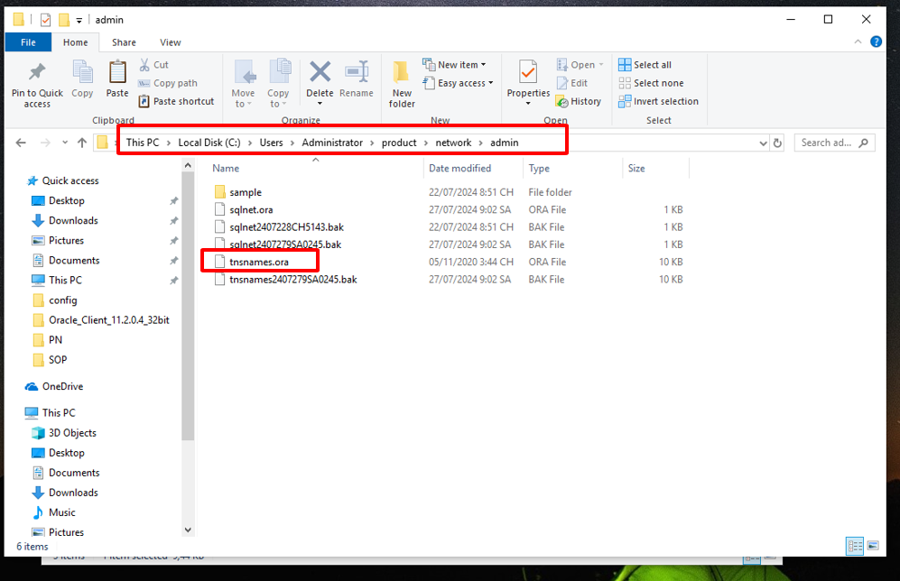
Step 12. 1. Login into “ Local Disk C\ Users \ Adminstrator\ product\ network\ admin” 2. Paste the file “ tnsnames.ora” to here same as the picture below. Note: We need to restart the PC after software install finished. The Oracle Client software install completed, ready to use.

